Slide 1

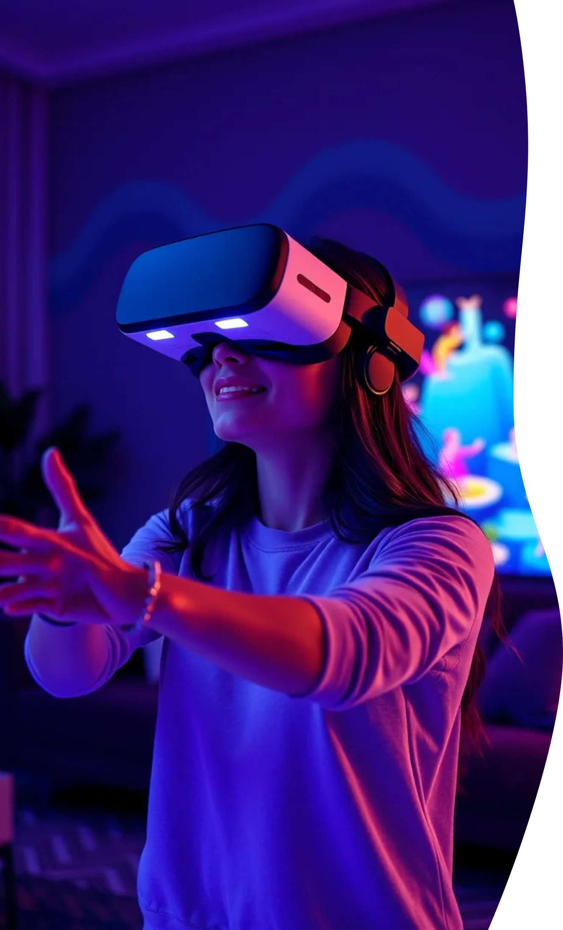
Virtual Reality Overview
Virtual Reality (VR) is an immersive technology that simulates a realistic environment, allowing users to interact with 3D worlds through specialized equipment. It has gained popularity in various fields, including gaming, education, and healthcare. This presentation will explore the fundamentals of VR, its key technologies, applications, benefits, challenges, and future prospects.

Slide 2


CONTENTS(1)
What is Virtual Reality?
Key VR Technologies
Applications of VR

Slide 3
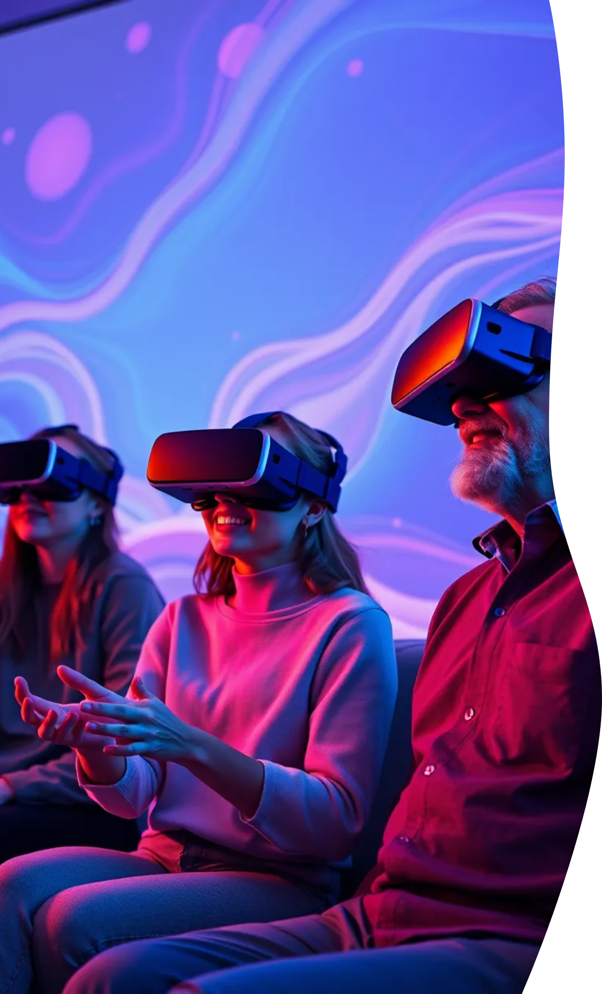

CONTENTS(2)
Benefits of VR
Challenges in VR
Future of VR
Conclusion

Slide 4
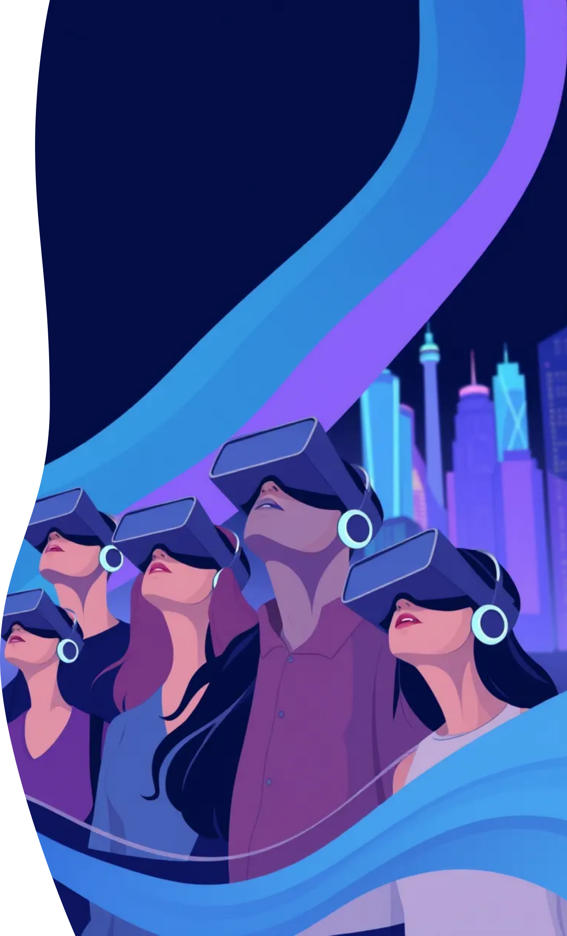

What is Virtual Reality?
Immersive Experience
Interactive Elements
Realistic Simulations
Virtual reality creates a simulated environment.
Users can interact with the virtual world.
It mimics real-world scenarios for training.

Slide 5

Key VR Technologies
Virtual Reality Headsets
Motion Tracking
Haptic Feedback
Devices that provide immersive experiences.
Technology that tracks user movements.
Technology that simulates touch sensations.

Slide 6


VR Technologies
Meta Quest
PSVR 2
Apple Vision Pro
Features standalone capabilities and social interaction in virtual spaces.
Delivers high-fidelity graphics and haptic feedback for PlayStation gaming.
Combines AR and VR for a mixed-reality experience.

Slide 7





Virtual Reality Technologies Utilization
Interactive Gaming
Virtual Reality in Education
Professional Training with VR
Therapeutic Uses of Virtual Reality
Immersive gameplay in imaginative environments.
Simulations for experiential education across disciplines.
Realistic simulations for professional development in key sectors.
VR is used in exposure therapy for phobias and PTSD treatment.

Slide 8
Advantages of VR Technology
Enhancing Educational Outcomes
VR in Clinical Applications
Collaboration in Virtual Spaces
VR aids in pain management and mental health.
Engaging experiences enhance memory and comprehension.
Enhancing collaboration effectiveness on digital platforms.

Slide 9
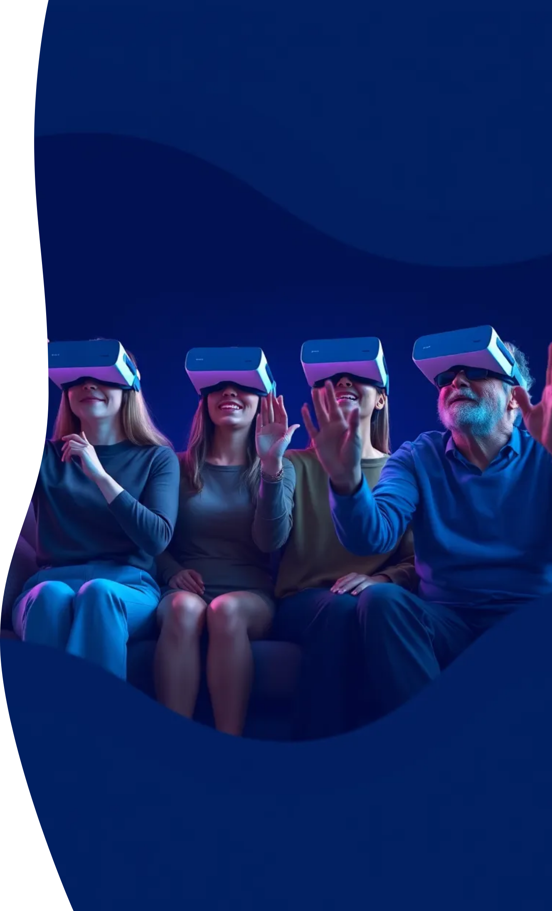



Challenges in VR
High Costs
Technical Limitations
User Discomfort
Developing VR technology requires significant investment.
Current hardware may not support advanced VR experiences.
Some users experience motion sickness while using VR.

Slide 10


Future of VR
1
Enhanced Immersion
2
Wider Applications
3
Social Interaction
Future VR will provide even more realistic experiences.
VR will enable new forms of social engagement.
VR will be used in education, healthcare, and entertainment.

Slide 11
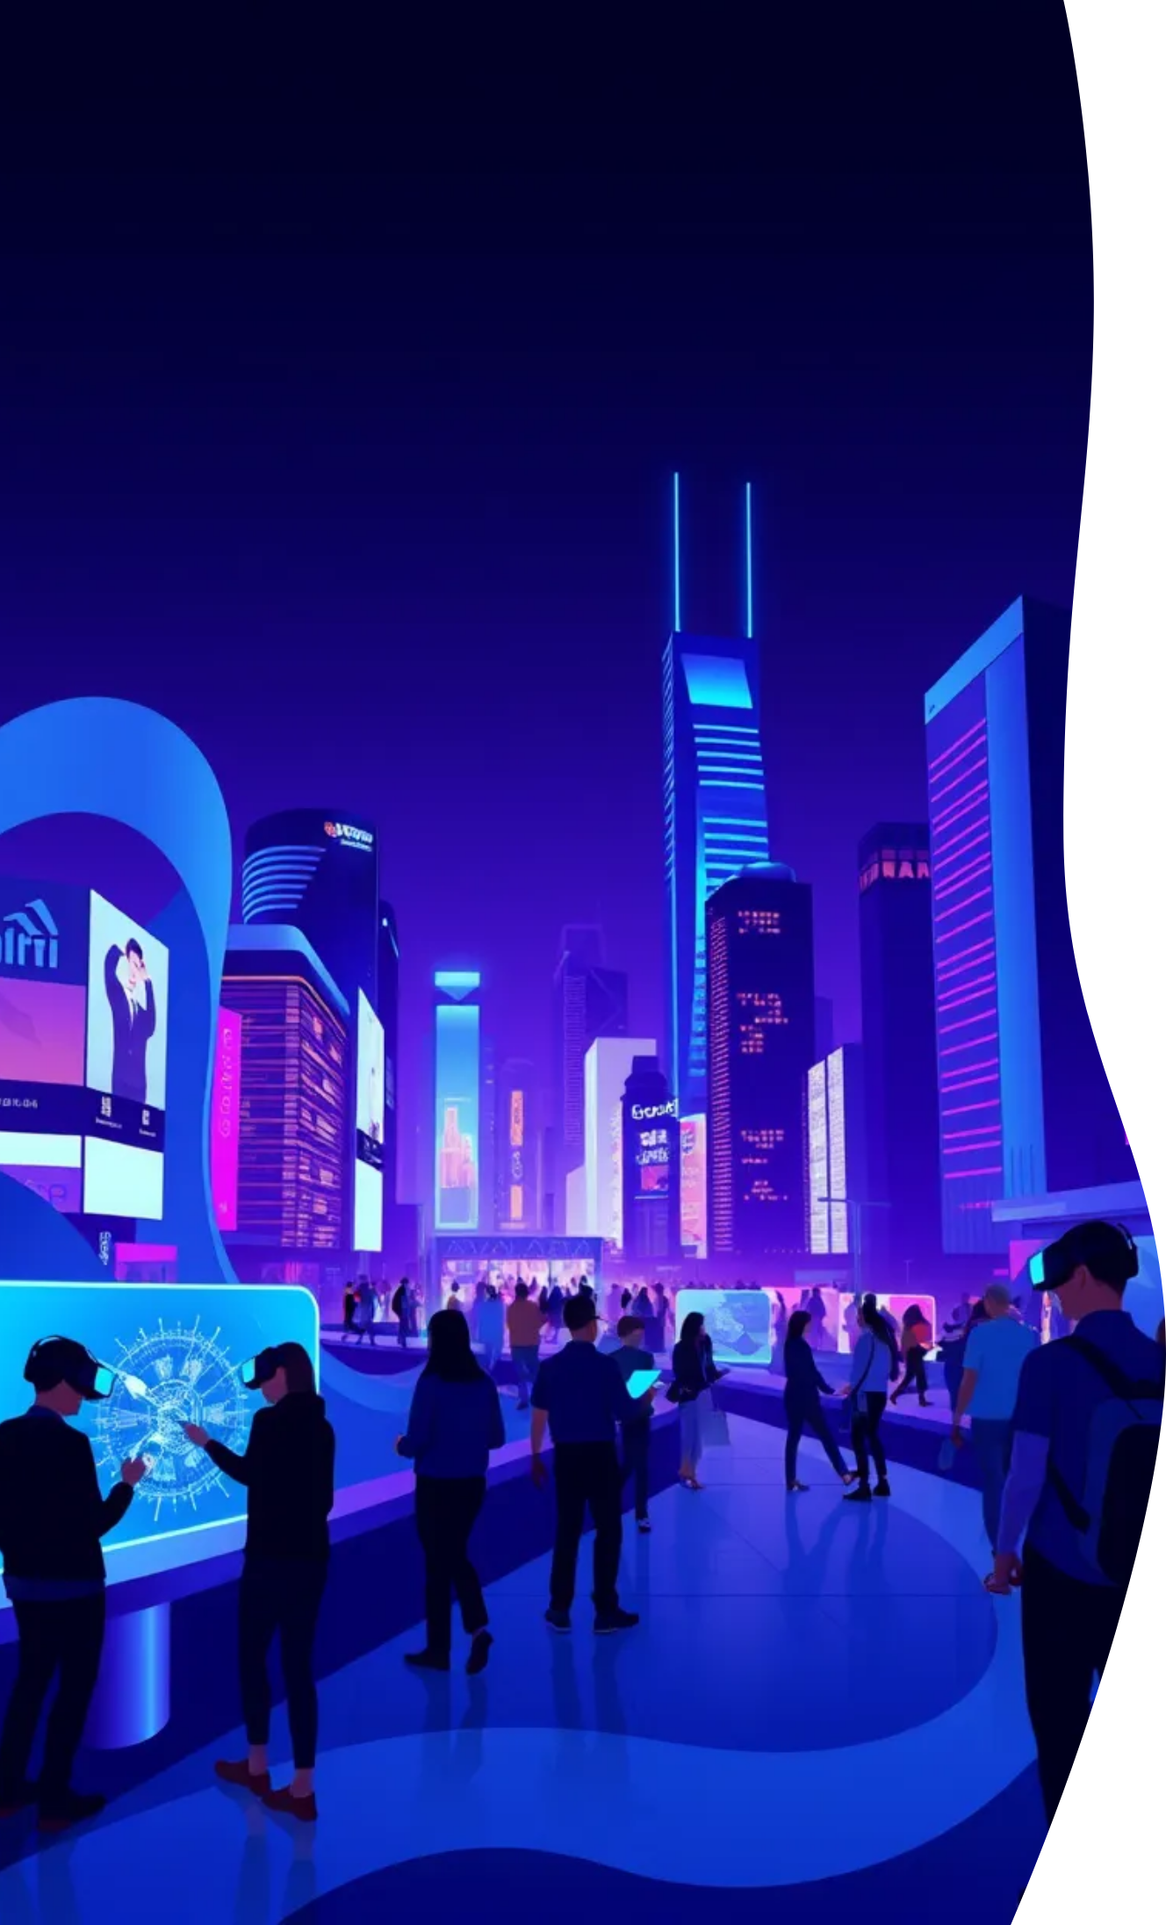
Conclusion
1
Embracing VR
2
Future Innovations
3
Wider Adoption
Virtual Reality is transforming experiences.
More industries will integrate VR solutions.
Expect advancements in technology and applications.

Slide 12

Thank You
Appreciation
Questions
Feedback
Thank you for your attention.
Feel free to ask any questions.
Your feedback is valuable to us.

